Slide 1


Slide 2

Who We Are?
Korada Srinivas Kalyan
191CS130
Yenumula Venkat Kumar
191CS263
L S V Sandeep M
191CS226
Tummala Ajay
191CS259

Slide 3

About GOSSIP
GOSSIP is a mobile based application that connects the students socially with their friends and to explore the lifestyle of their friends. The proposed systems includes several components such as authentication, chat module, profile manager, and posts manager.
In order to better engage students in the learner process the GOSSIP facilitate and automate students and instructors’ interaction through a set of services similar to those present in social networks.

Slide 4
Description
During this pandemic situation we all know how badly we are missing our college and friends. We love to share our experiences with each other. And now some people are off to campus and the rest couldn’t. They like to share their college experiences with others in the college. So, we don’t find a social media platform restricted to users with in the campus.
Keeping a view on this we would like to develop a intra-campus social media application restricted to users with in the college. This type of application plays a crucial role in connecting people and developing relations, not only students of a batch but also with other batches and clubs as well. The application includes, posting images and ideas, chat module and profile info.

Slide 5
OUTCOME AND REQUIREMENTS

Slide 6




Tools Used to Shape-out GOSSIP
React Native
Material UI
Expo
Firebase
Android Studio
Text Editor

Slide 7



User requirements to use GOSSIP
Android 4.1 or higher versions/ IOS (Preferred Pie Version – 12)
Internet connection with good bandwidth
To run Android Studio 4GB RAM and 10GB Free Space in OS Required

Slide 8
Features of GOSSIP
Authentication
Users
Users
Profile
Chat
Home
Profile
User Details
Create Post
Delete Post
4. Chat
Users List
Messaging
Previous Chats
Home
Friends Profile
Home feed

Slide 9
WATERFALL MODEL
Waterfall process model is used in our project GOSSIP. This model is generally applied to the projects where the requirements are very clear and the customer keeps on patience. Different phases of model are as follows.
Feasibility Study
Requirement Gathering and Analysis
System Design
Implementation
Testing
Maintenance
Security

Slide 10
FEASIBILITY STUDY
Feasibility Study determine whether it would be financially and technically feasible to develop the software.
Since it is a small scale social application provides simple services such as essaying, feed etc.
This application is cost effective for users as it consists of messaging as well as posting modules in the same application
Thus, build this application feels feasible to us with the resources that we have.

Slide 11
REQUIREMENT GATHERING
To provide a safe environment for user friendly interactions.
To provide fast, efficient and reliable system that manages all actions
To provide an efficient system that allows users to communicate with each other
Effective maintenance of the database
To build a feature rich for automatic news feed and chat screen
To provide a platform itself being a secure application for private messaging.
To maximize profit by increasing efficiency and decreasing overheads without compromising customer satisfaction

Slide 12
REQUIREMENT ANALYSIS
Initially we have listed few ideas upon creating a mobile application with some novelty. Finally settled with Intra Campus Social Media application and created an SRS on it. That SRS includes all the possible requirements to be developed and all the components that must be included in it.
The components are:
Authentication – Login/Sign-Up page for users.
User Profile – User information along with the posts he shared
Chat Profile – Messaging module for one-to-one interactions.
User Home – Provides with feed that consists of the posts shared by users along with like functionality
Edit Profile – Functionality to edit user details

Slide 13
Data Flow Diagrams
Based on the above mentioned components screens must be developed in the user modules respectively.
Data Flow diagrams are made basing on the analysis done before.

Slide 14
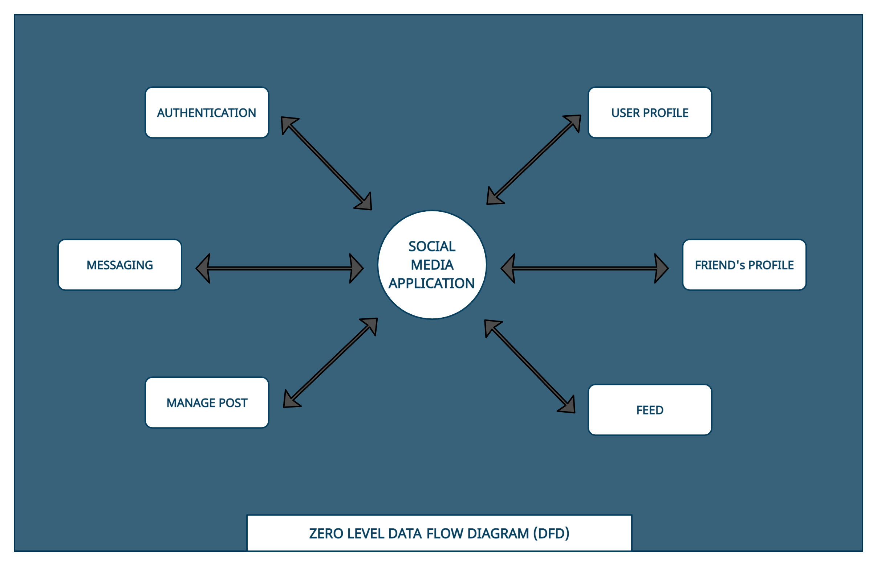
DFD LEVEL 0

Slide 15
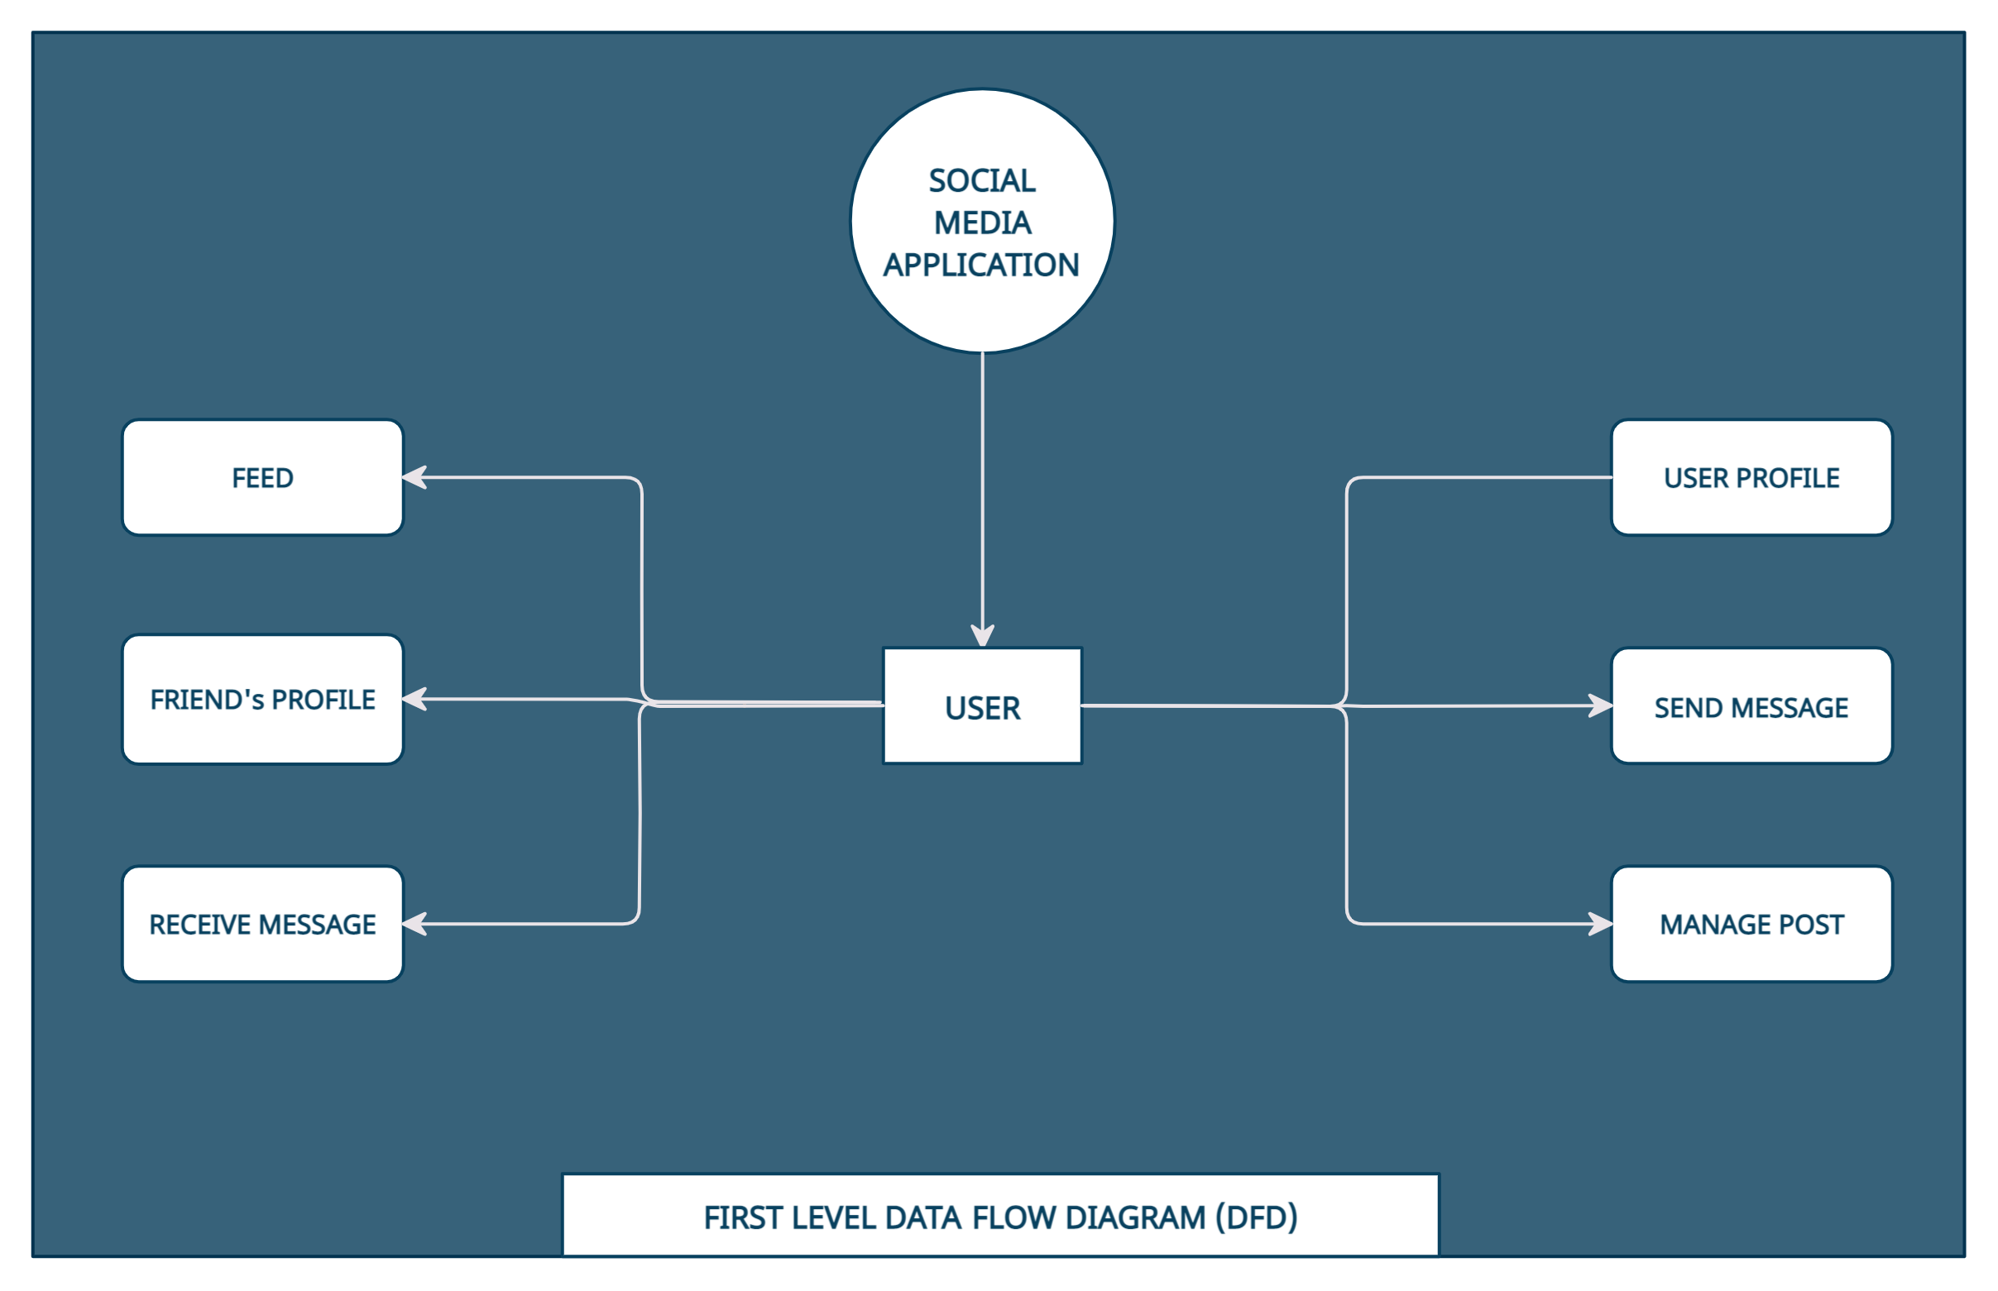
DFD LEVEL 1

Slide 16
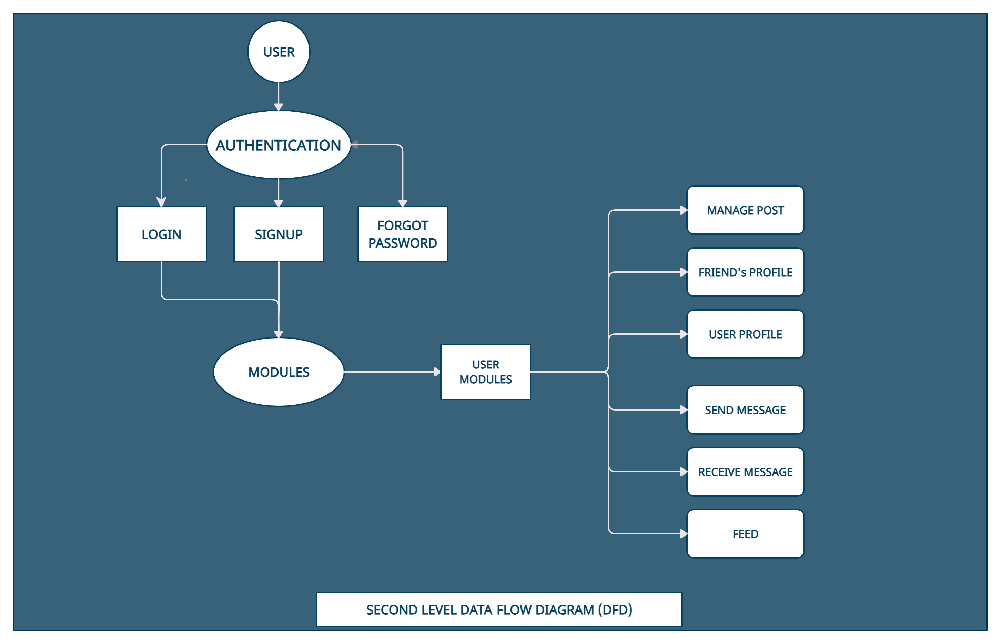
DFD LEVEL 2

Slide 17
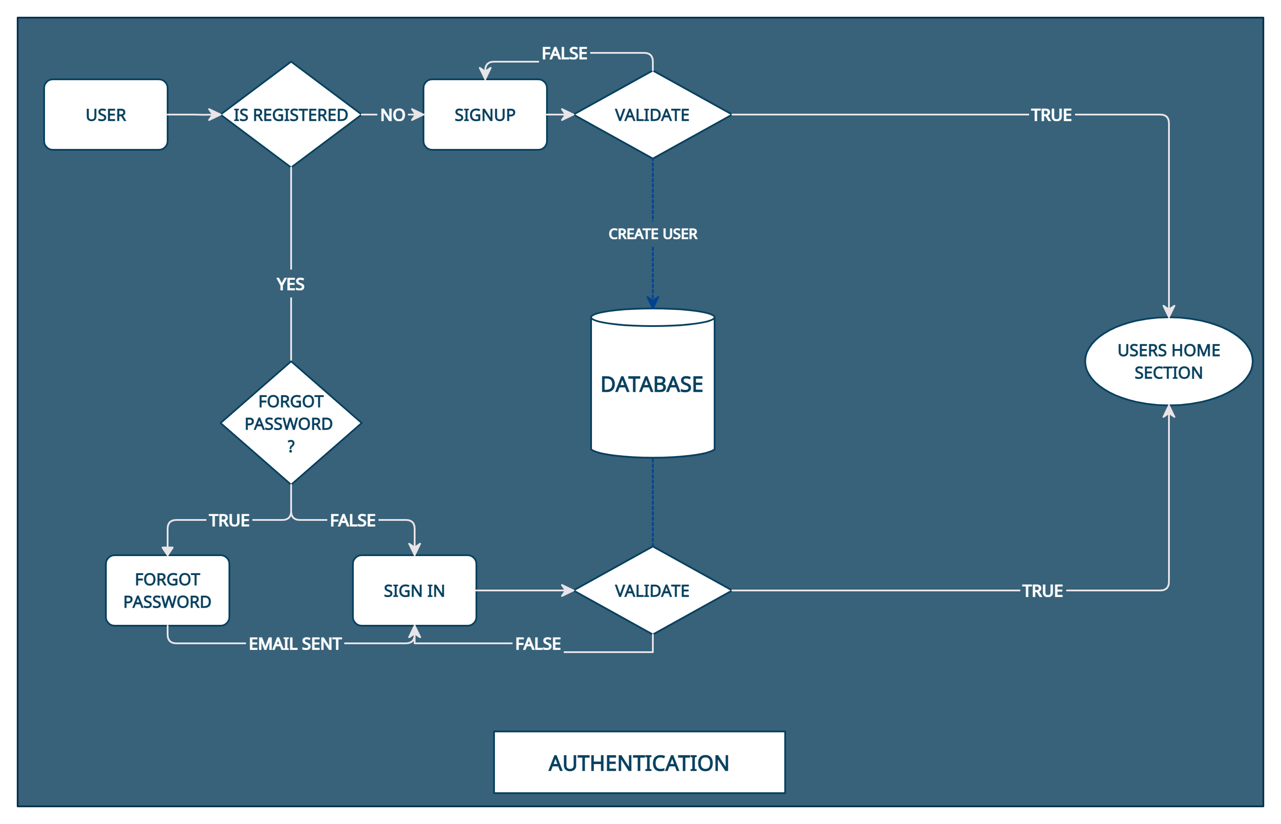
SYSTEM DESIGN

Slide 18
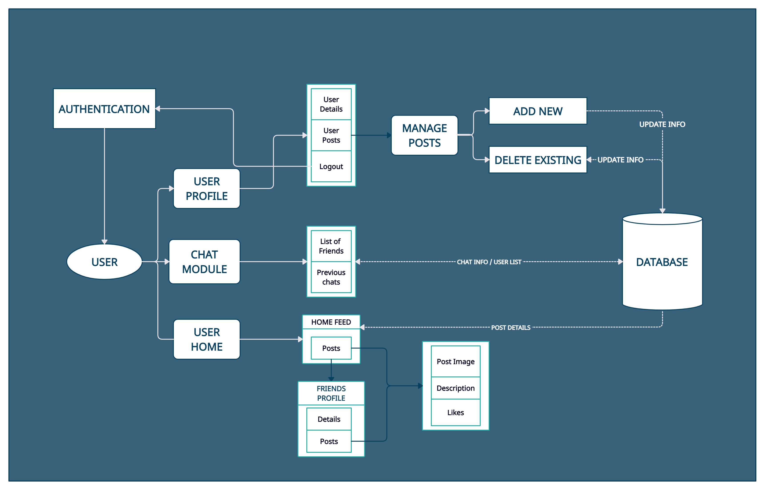
SYSTEM DESIGN (Contd..)

Slide 19
IMPLEMENTATION
After getting all the required software and hardware, the app is build. I.e., the coding part.
This is done using visual studio as our code editor.
Initially the authentication part is developed using a navigation component named Auth Provider that connects to the firebase authentication where the login details of existing users are present and can also add the credentials of new user.
After authentication it is redirected to the user module.
All the different pages that are generated are created in a folder named screens.
Navigation through screens can be managed by created a file named routes where different components can be linked in order to navigate from one screen to other.
A tab bar is implemented within the application for easy use .
Tab Bar consists of home, chat and profile screens
The resulting screens are shown below:

Slide 20
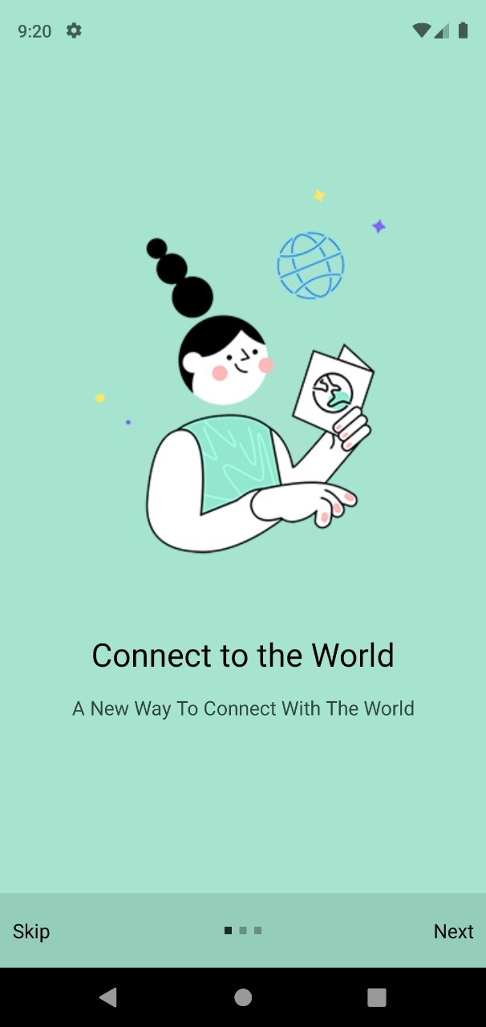
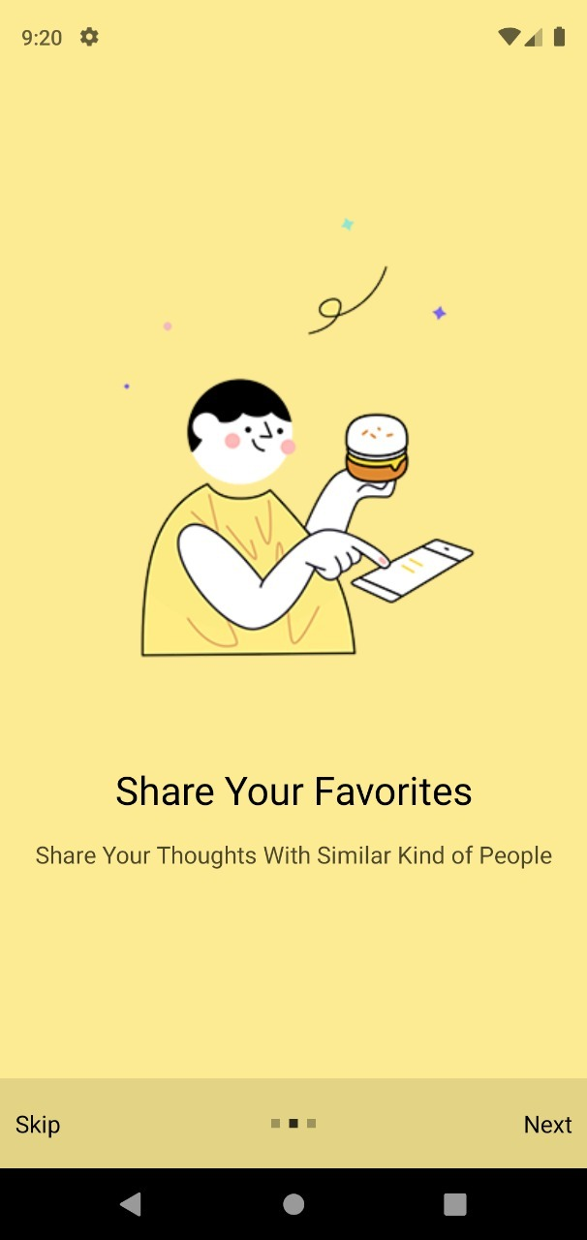
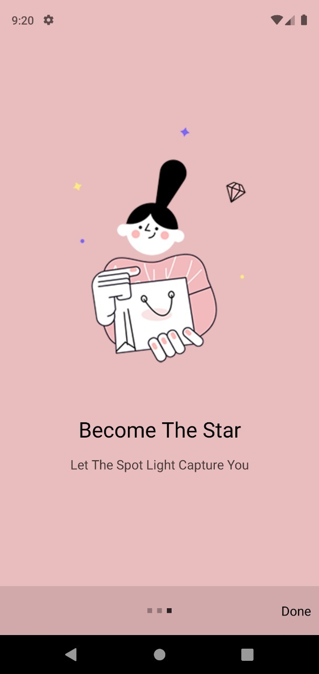
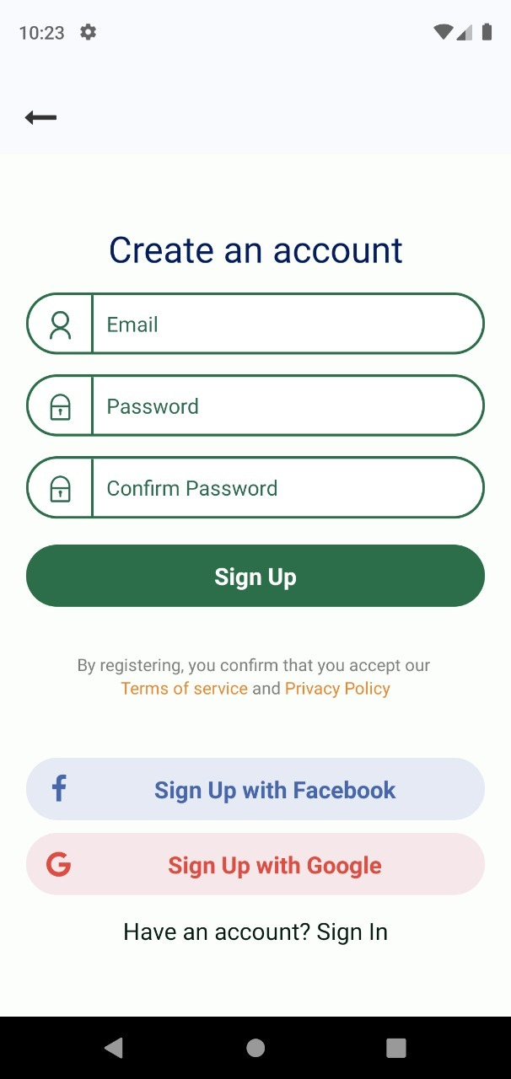
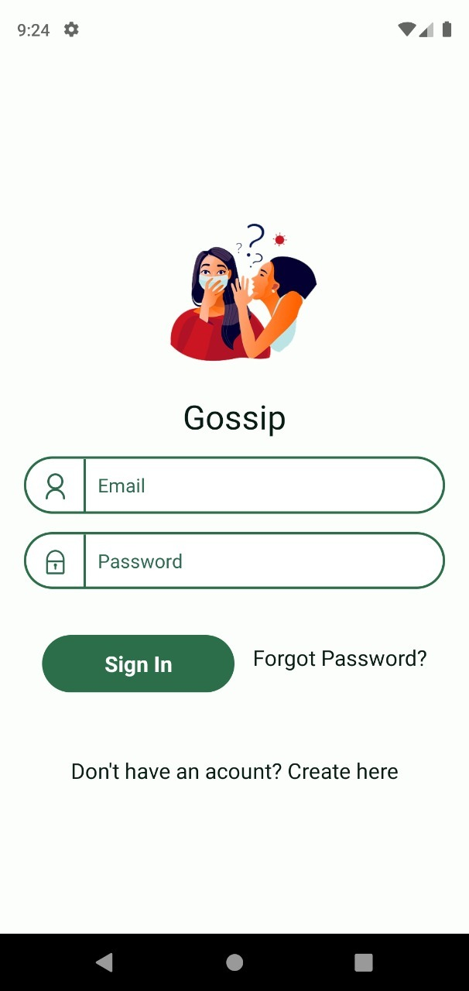
Screens
Onboarding Screens
Sign Up Screen
Login Screen

Slide 21
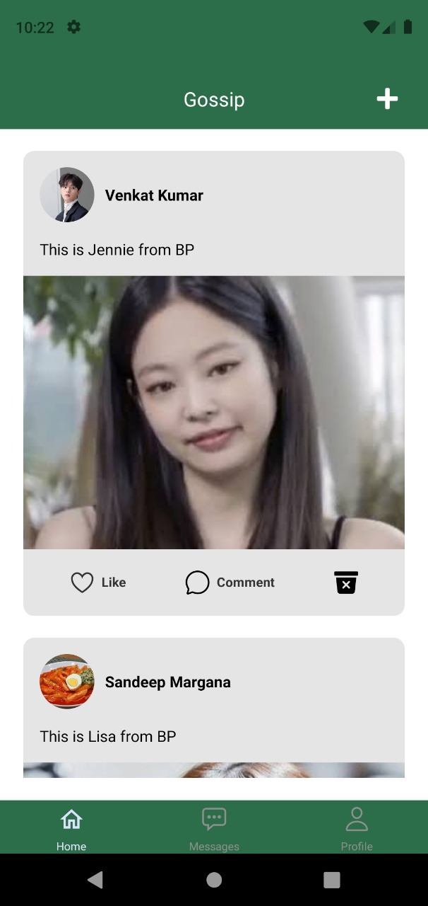
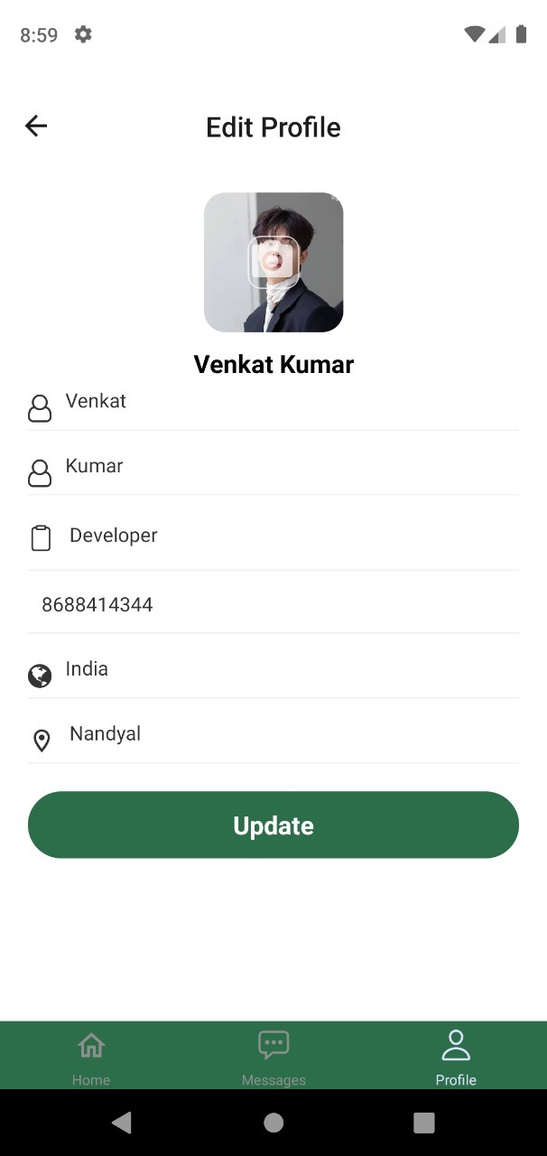
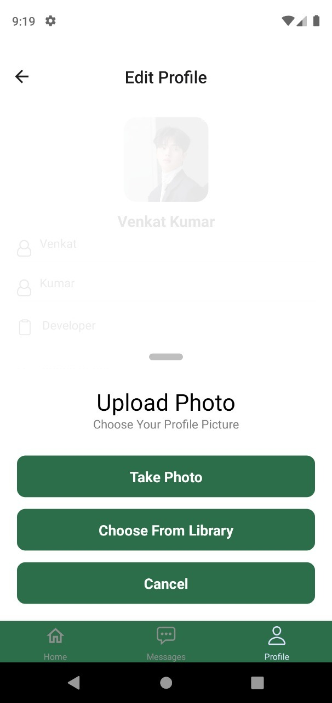
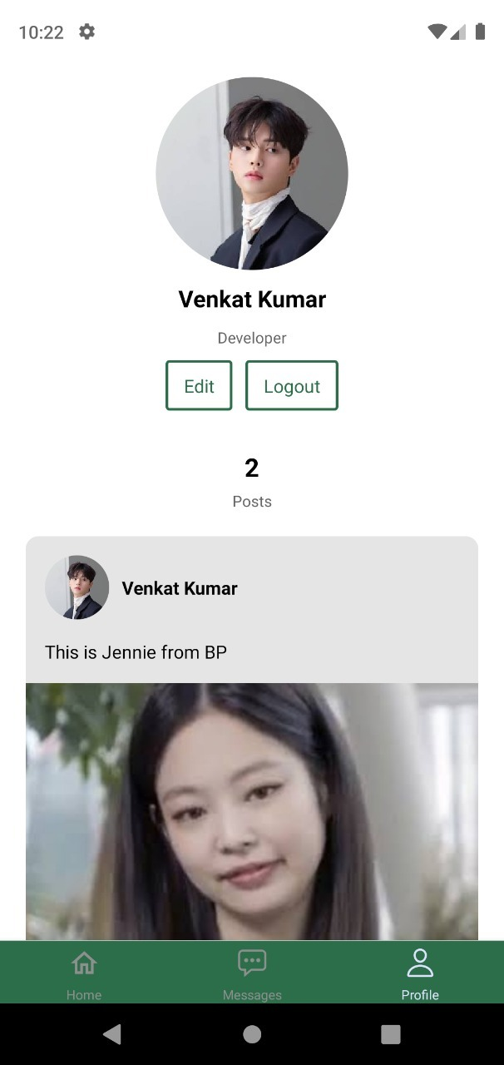
Screens
Feed Screen
Edit Profile Screens
User Profile

Slide 22
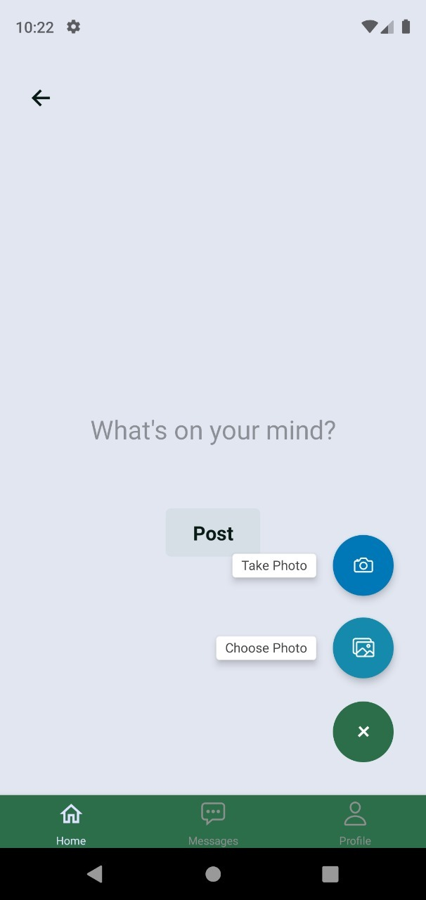
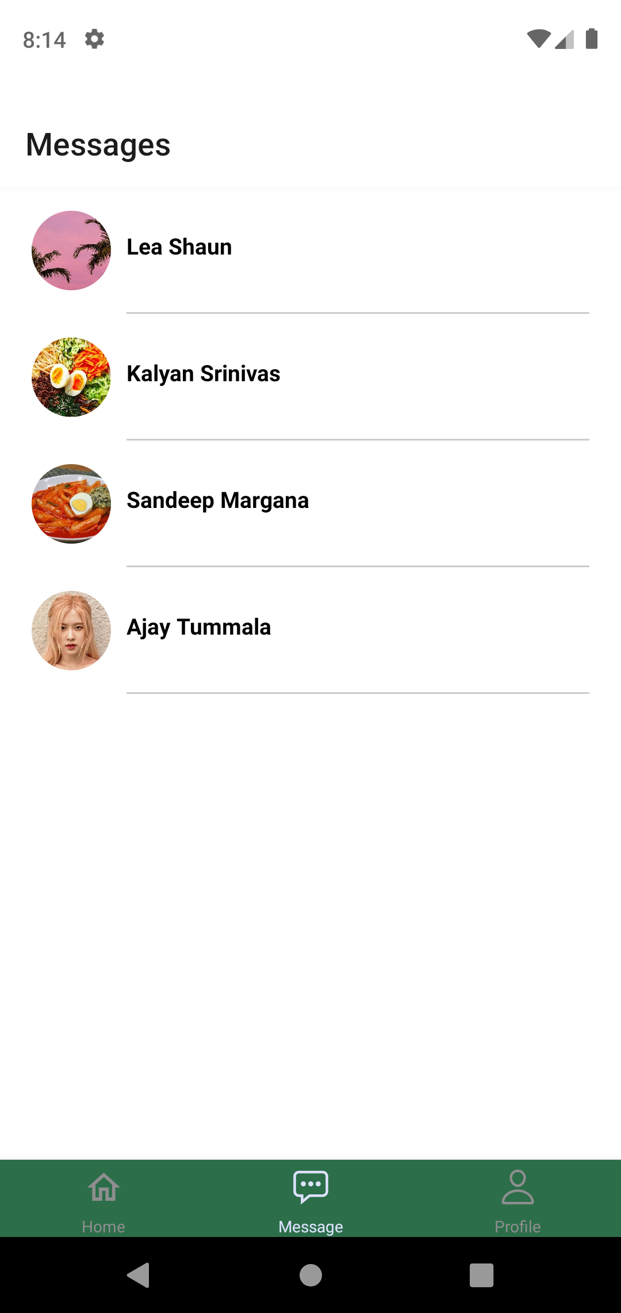
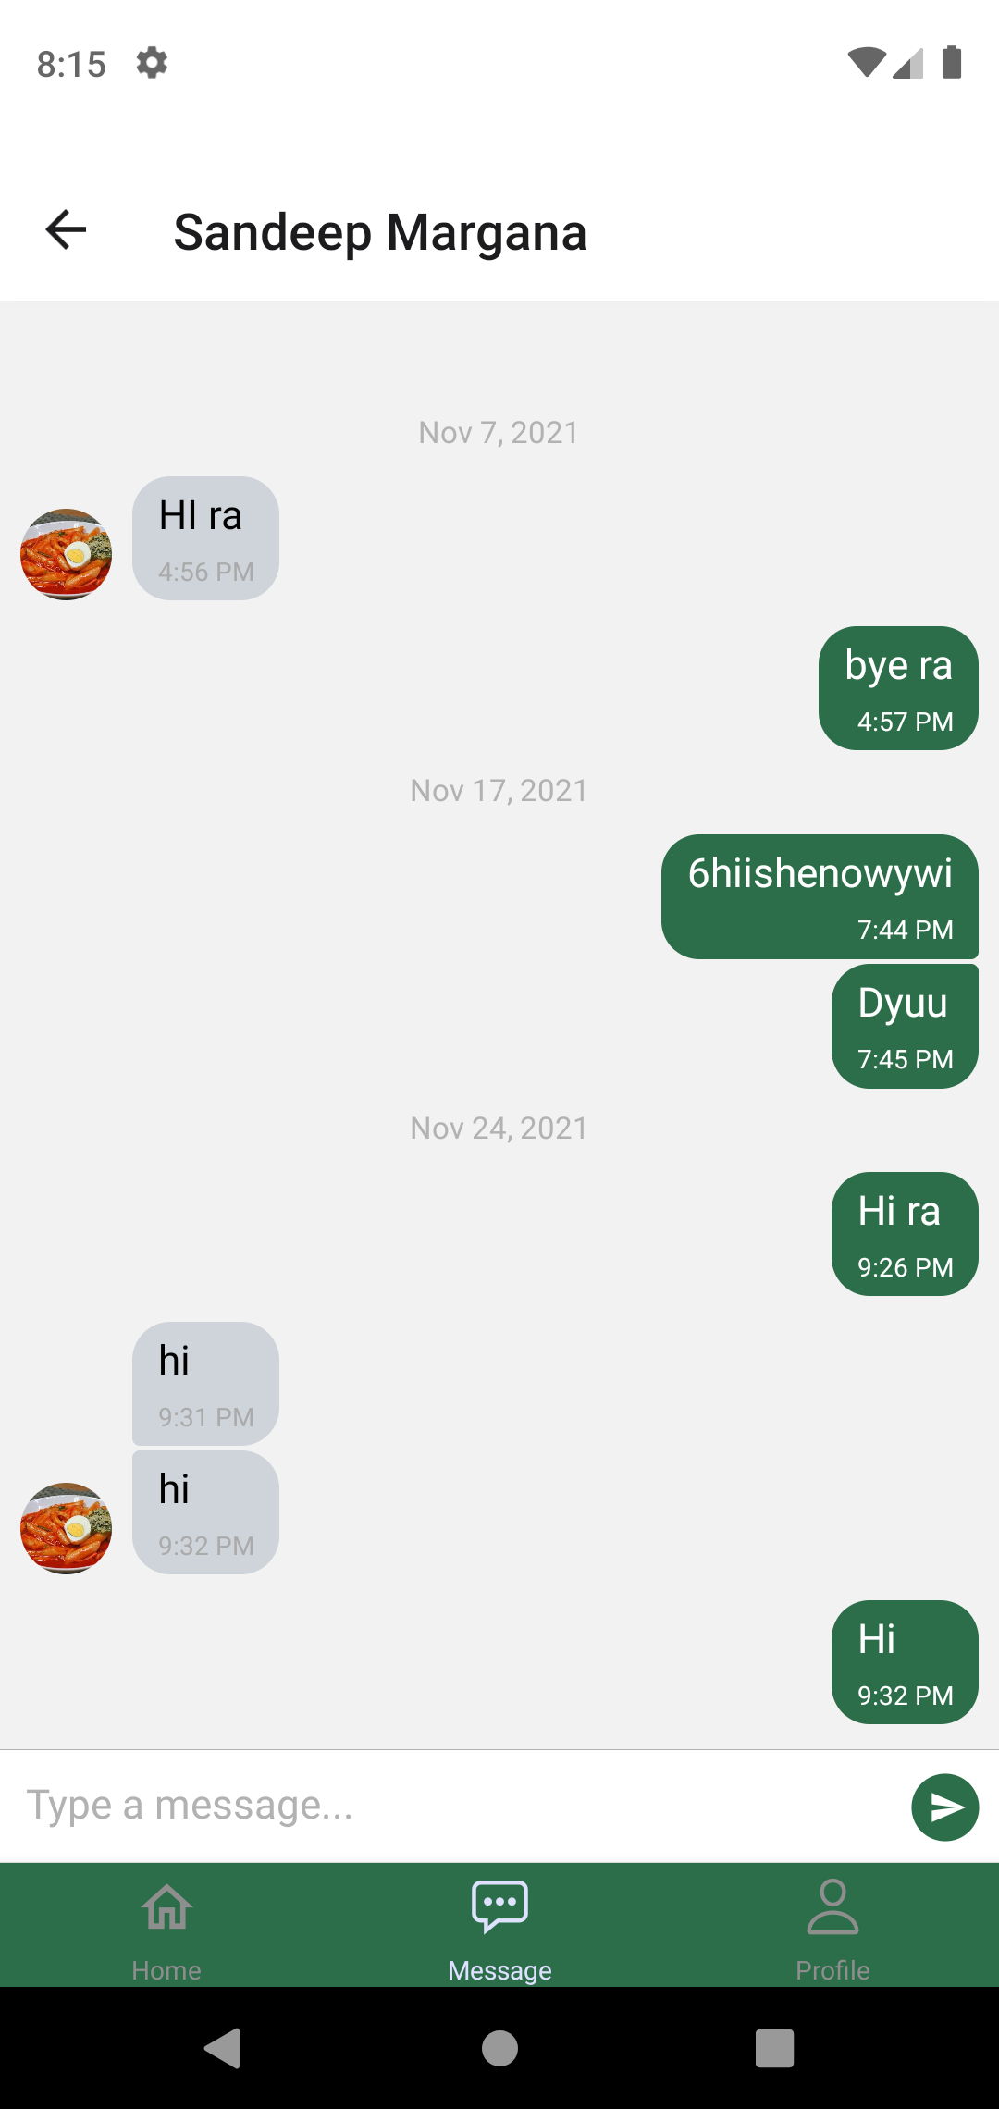
Screens
Add Post Screen
Messaging Screen
Chat Screen

Slide 23
TESTING
We have tested our application using firebase testlab which is a cloud-based app testing tool that lets an app test on a range of devices and configurations and displays the result in a test matrix.
From the list of various tests we have chose robo test to test our application which captures the log files and saves a series of screenshots and creates a video based on the simulation process.
The robo test crawl shows the stats regarding the actions, activities and screens that occur during the test.
A complete flowchart is generated which runs through the entire application and trigger each activity buttons and test in several ways possible.
Few bugs regarding the authentication page have been trigger and have been rectified later.
A final report is generated which shows the compatibility of the application.
The application is tested again after rectifying the bugs and a final report is generated where all the bugs have been rectified, stating the app is safe to use.

Slide 24
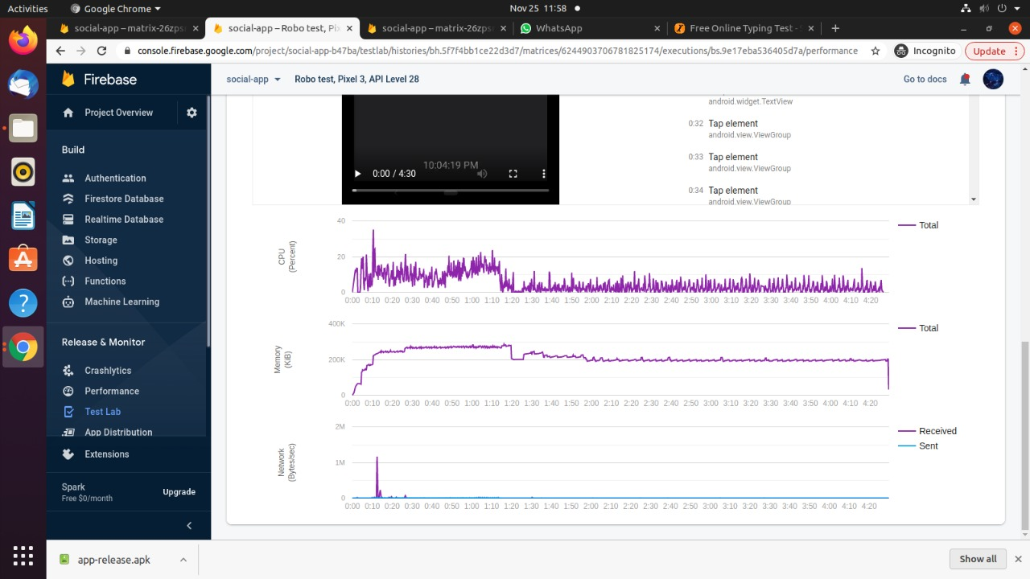
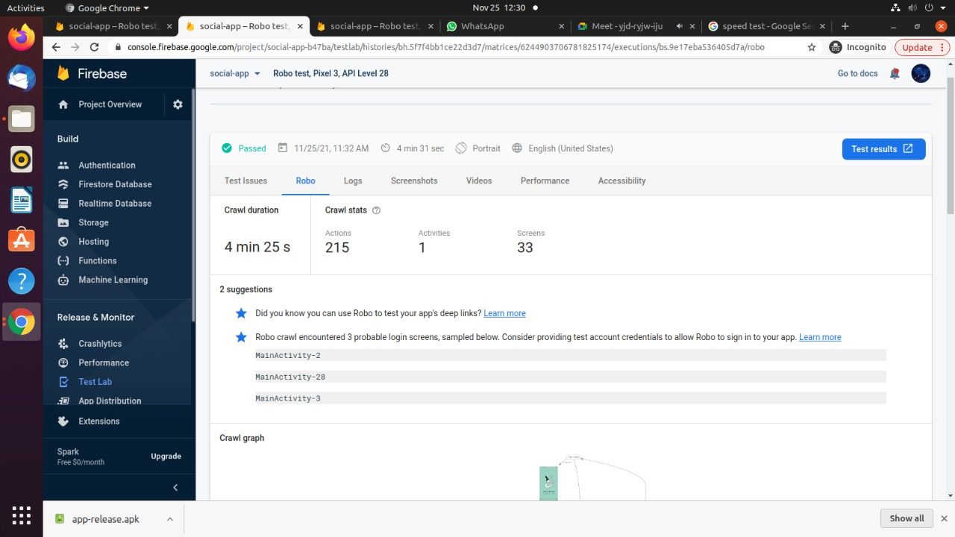
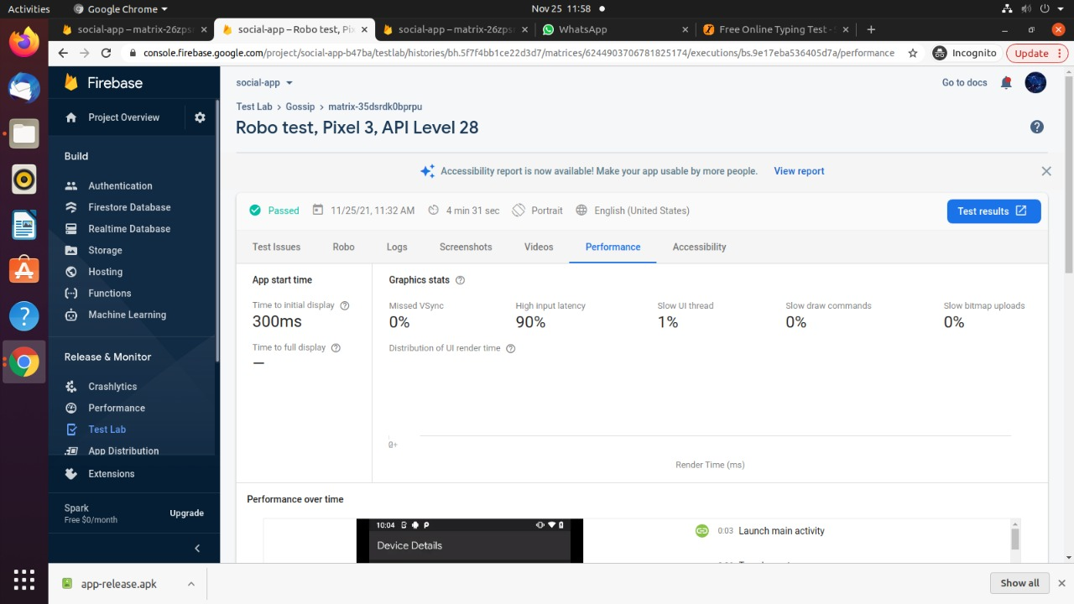
TESTING

Slide 25
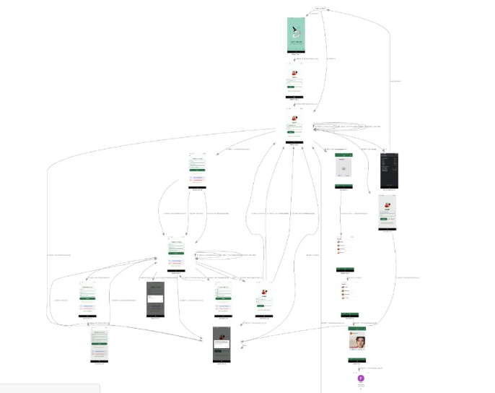
TESTING

Slide 26
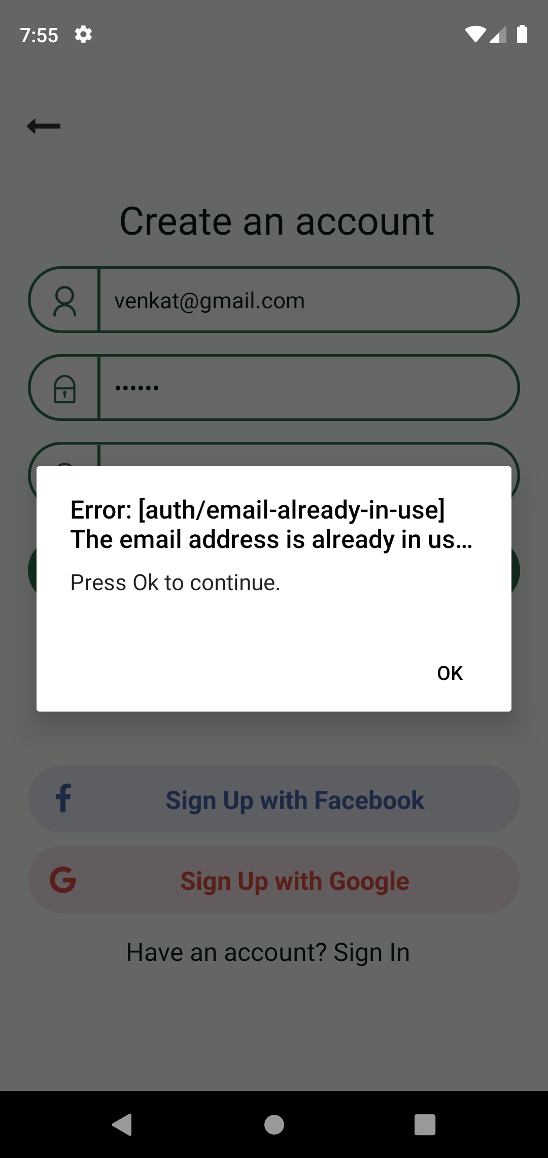

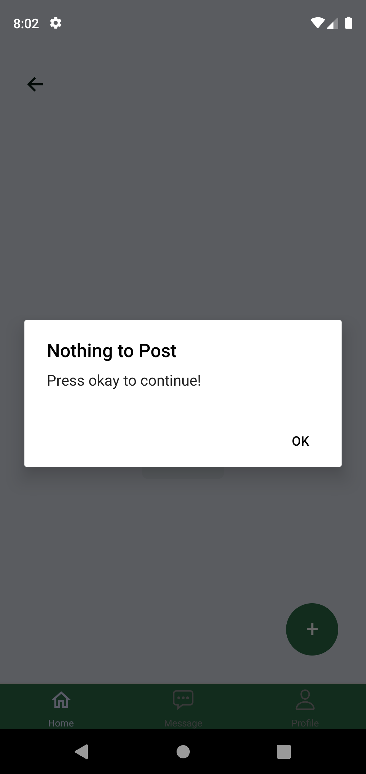
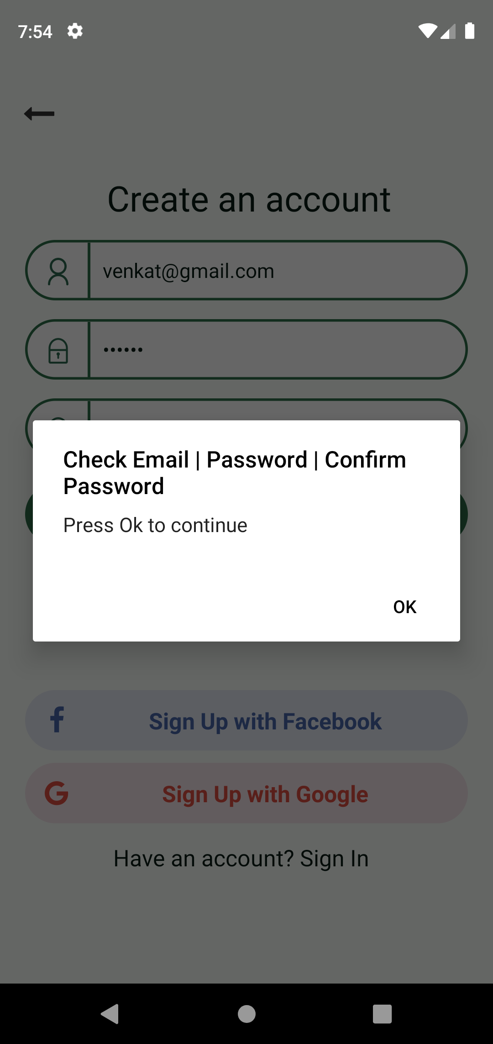
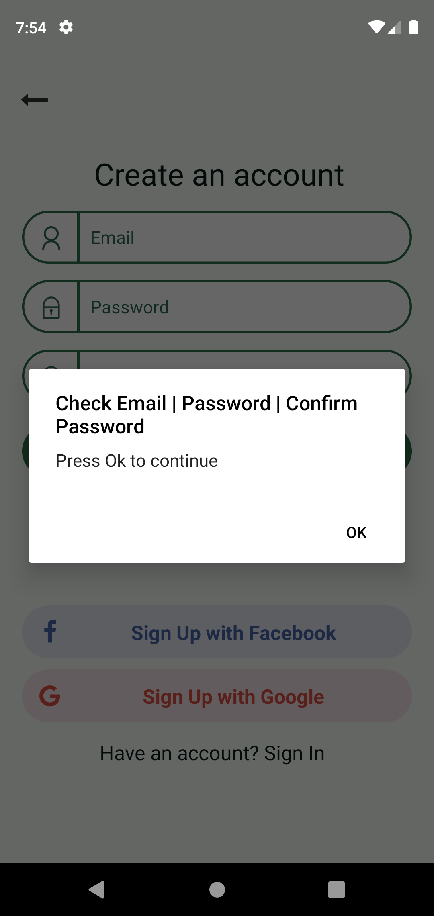
BUGS → that we resolved

Slide 27
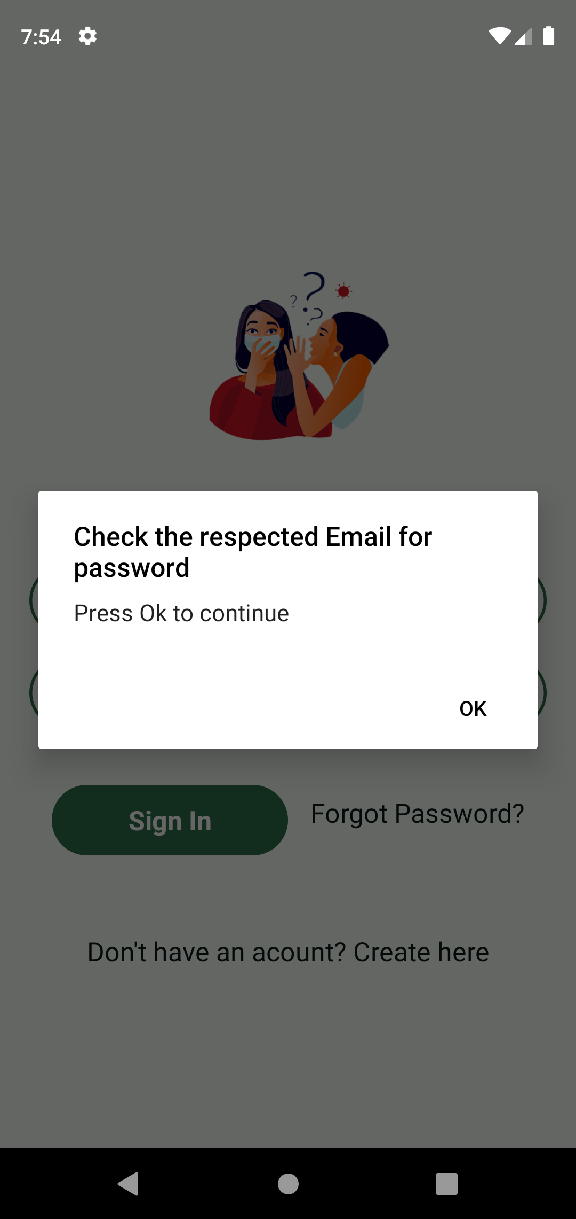
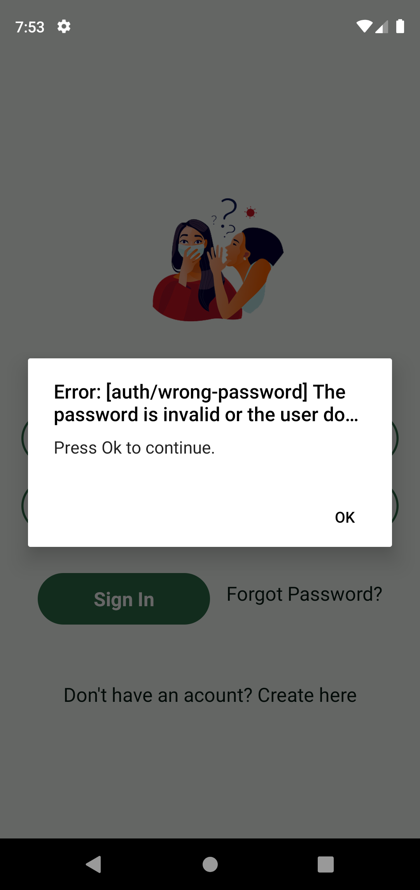

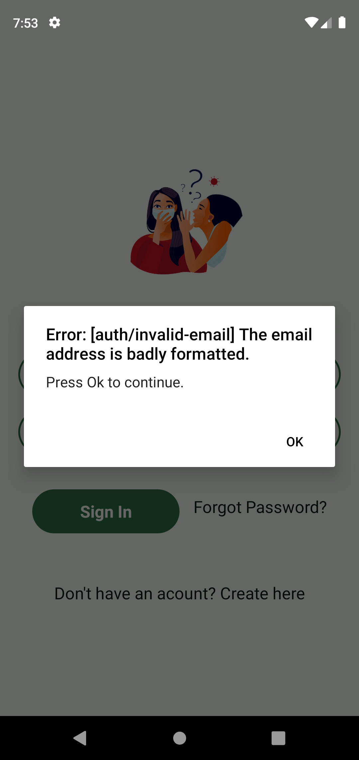

BUGS → that we resolved

Slide 28
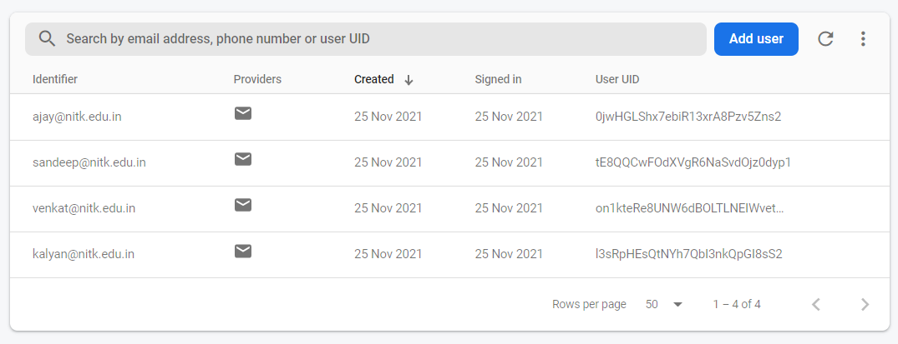
SECURITY
Coming to security concerns, Firebase Security Rules work by matching a pattern against database paths, and then applying custom conditions to allow access to data at those paths. All Rules across Firebase products have a path-matching component and a conditional statement allowing read or write access.
We have used O-Auth authentication that hashes the passwords during login so that the passwords cannot be retried even when the person gets the hash code. Each password will have a specific hash code that cannot be decoded back. So, this makes the authentication secure and make the users feel safe using our application.

Slide 29
MAINTAINANCE
As we know maintenance is an important part of the cycle that comprises the major part(around 60%) of the entire waterfall model. This is the process of enhancing and optimizing deployed software and rectifying defects.
Our application is maintained under the 4 categories of maintenance namely,
Corrective Maintenance – Majority of the bugs occurred during testing are rectified and some are to be taken care of. Once the app gets deployed, then some other bugs can be found and rectified based on user feedbacks.
Adaptive Maintenance – Implementing comments module when the application is set to release. Any further implementations can be taken care of based on user requests.
Perfective Maintenance – Some asynchronous actions while retrieving data from the database can be taken care of by providing loading screens or by creating some default component when the data is being rendered.
Preventive Maintenance – Technologies used in the development are of latest version. So, this issues will not occur in near time. This could be taken care later when required. A cloud storage that lasts longer must be chosen so that we could have a stable and secure database.

Slide 30
Summary
GOSSIP is an application that automates students interaction during pandemic situations.
To preserve the consistency in the user interface and functionality, the GOSSIP mainly provides the familiar features and activities
The Application can be further improved by including many other modules like search bar, using camera and gallery, campus guide etc..,
Overall this project helps in understanding the concepts of software Engineering.

Slide 31
Thank You

